Slide 1


Power Query Table Functions Part 1

Slide 2
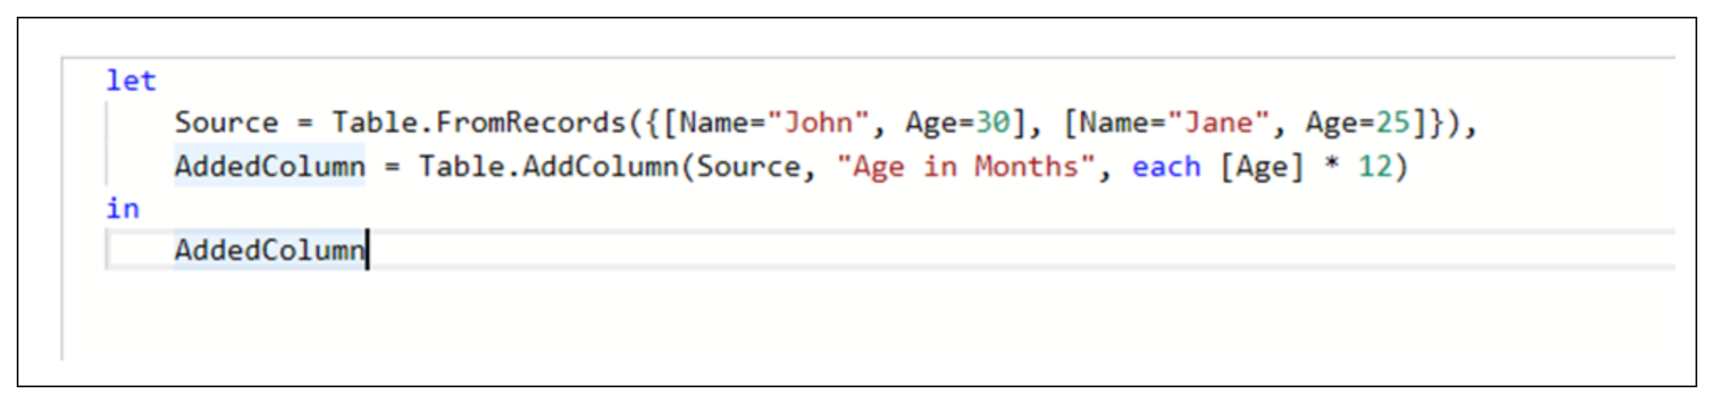
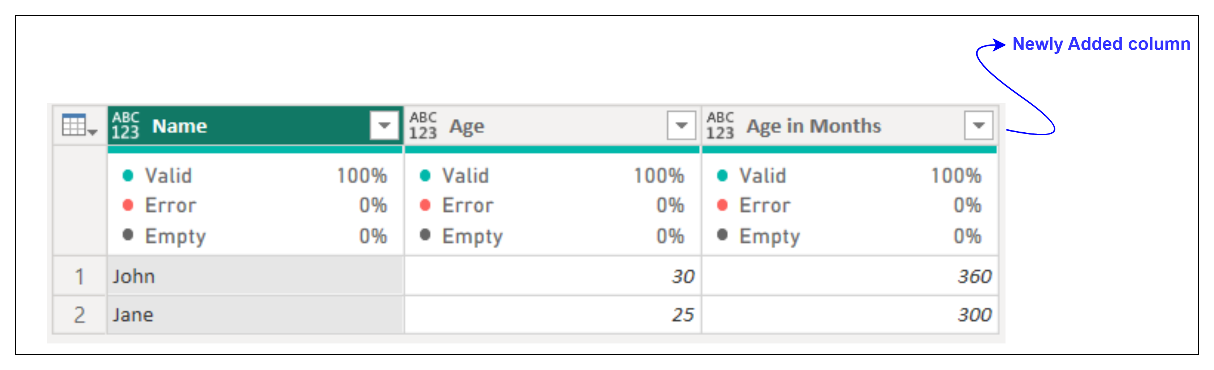
1. Table.AddColumn
Description: Adds a custom column to a table, using a formula to calculate the values.
Example:
Result:
Use Cases:
Adding calculated columns based on existing data.
Creating derived values like percentages, ranks, or aggregates

Slide 3
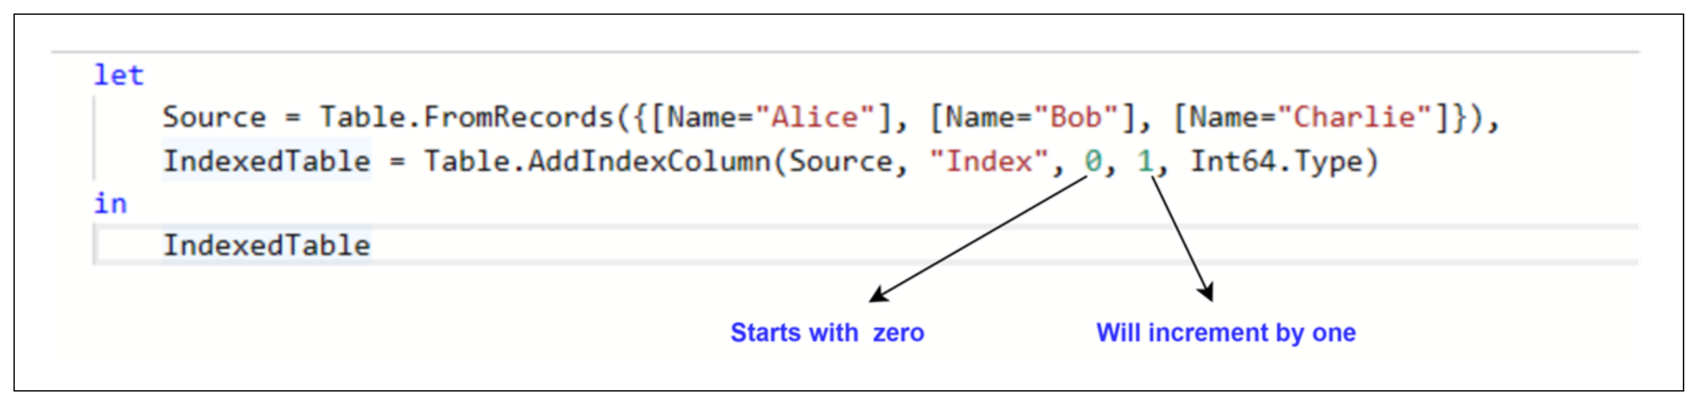
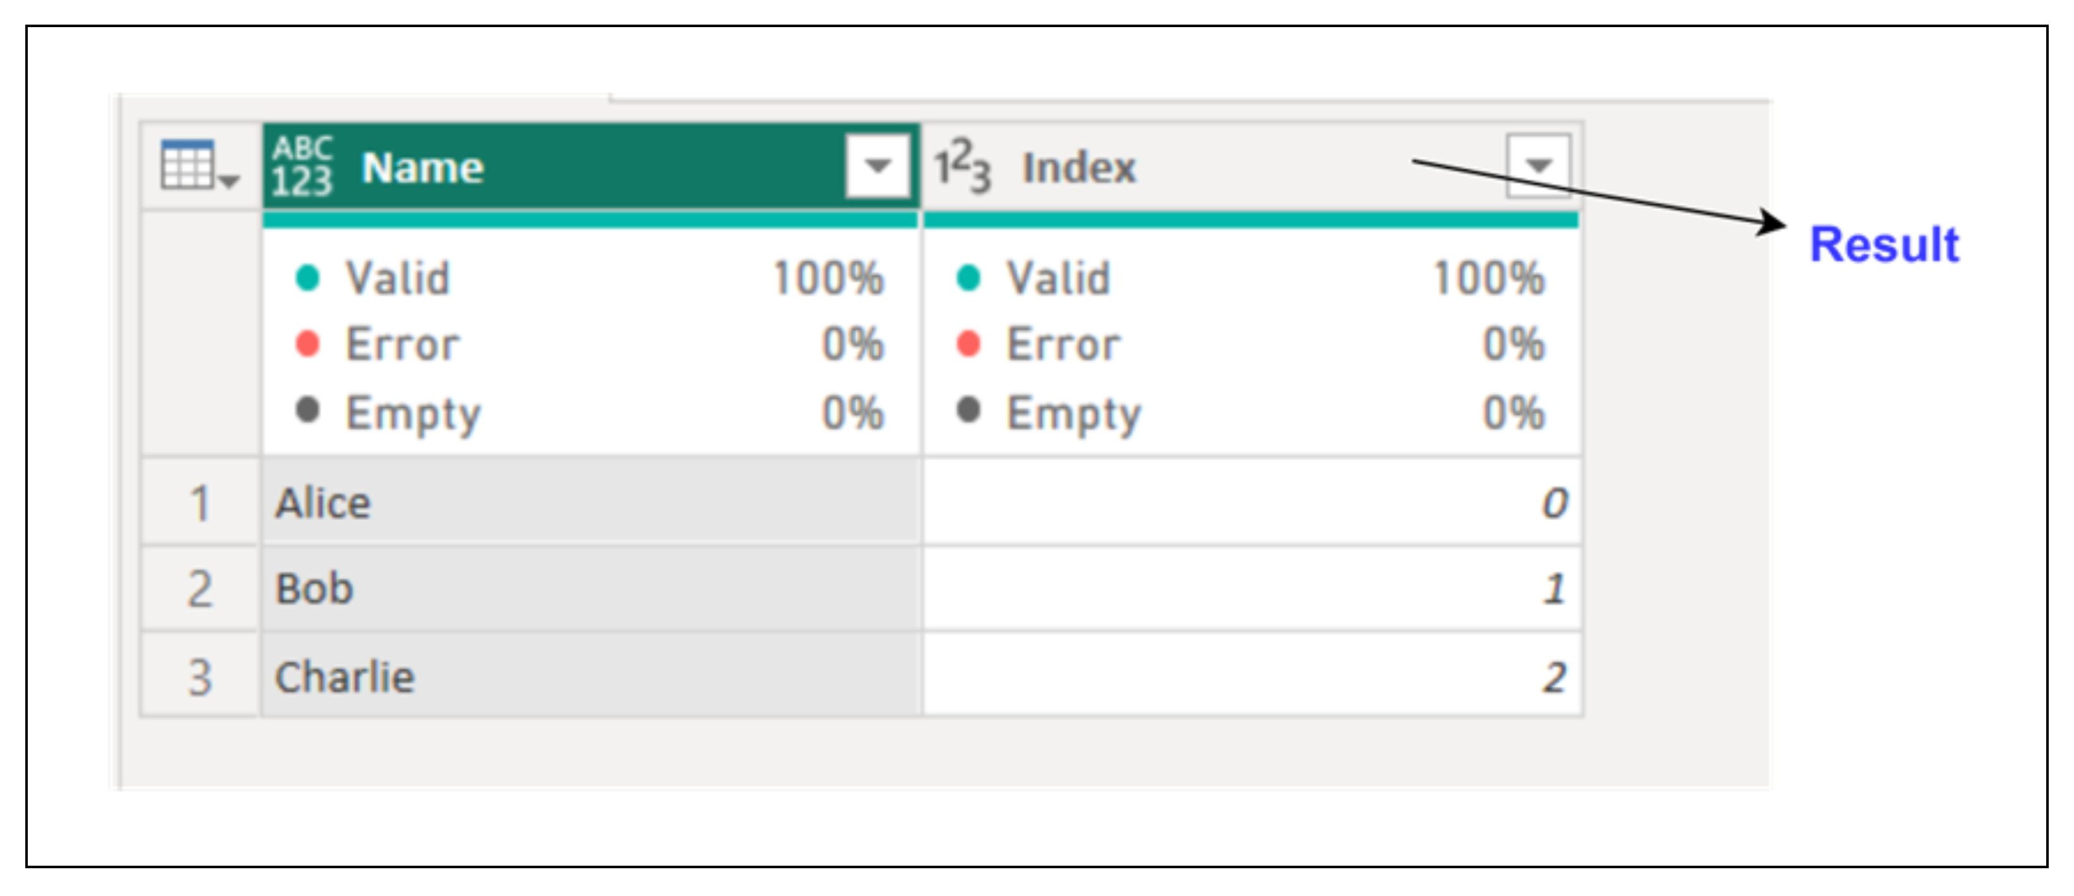
2. Table.AddIndexColumn
Description: Adds an index column to a table, starting from a specified initial value and increment.
Example:
Result:
Use Cases:
Creating unique identifiers for rows.
Sorting or ranking rows.

Slide 4
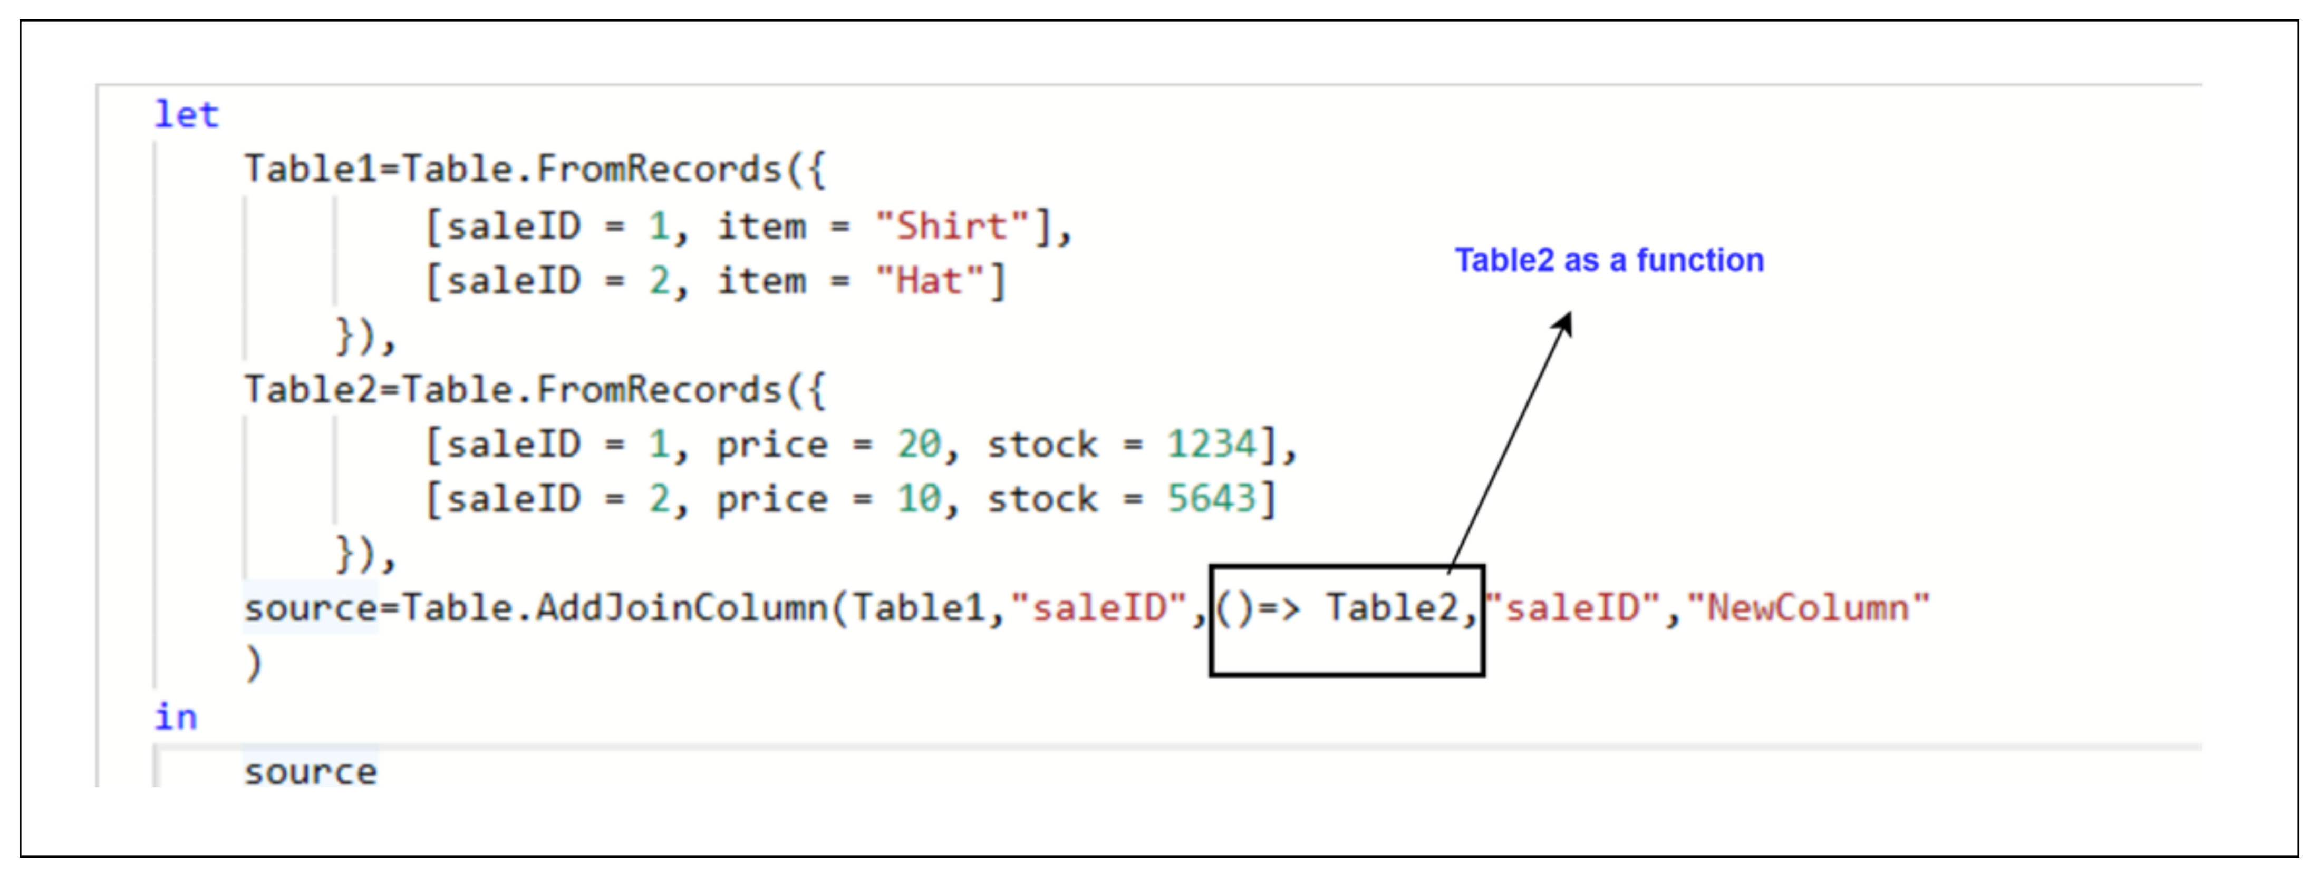
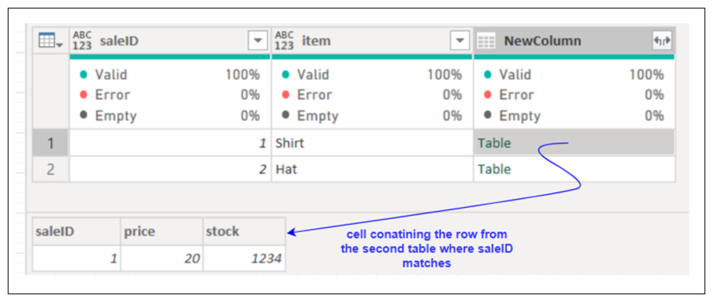
3. Table.AddJoinColumn
Description: Adds a column containing the rows of the join results from another table based on matching key values.
Example:
Result:
Use Cases:
Merging datasets with relationships.
Augmenting data by adding columns from related tables.

Slide 5
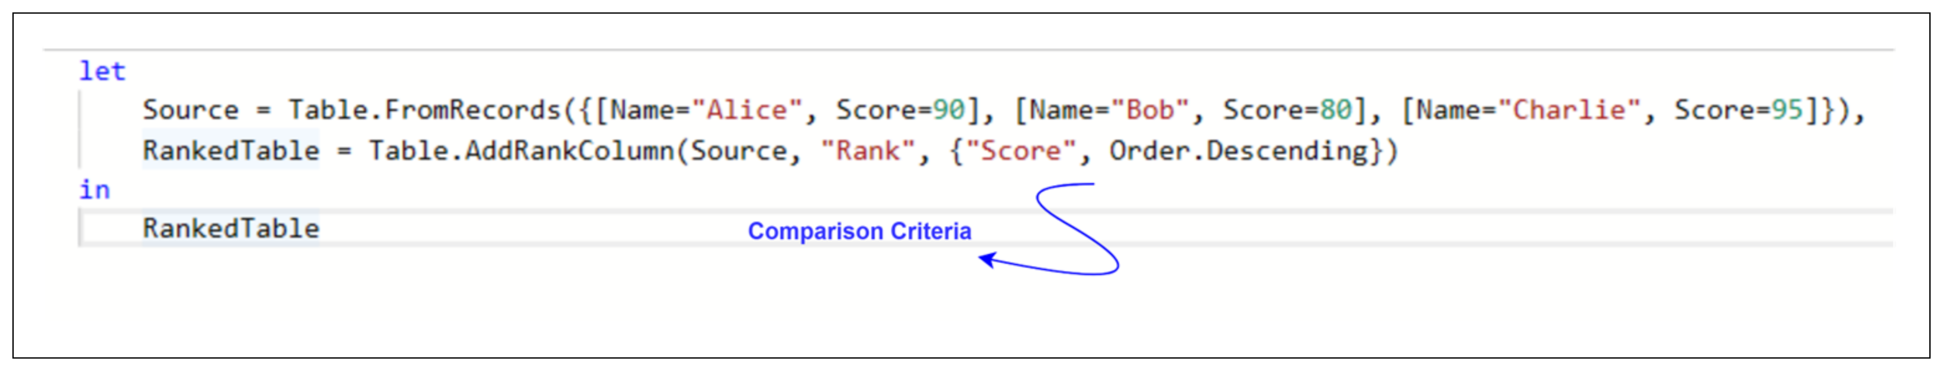
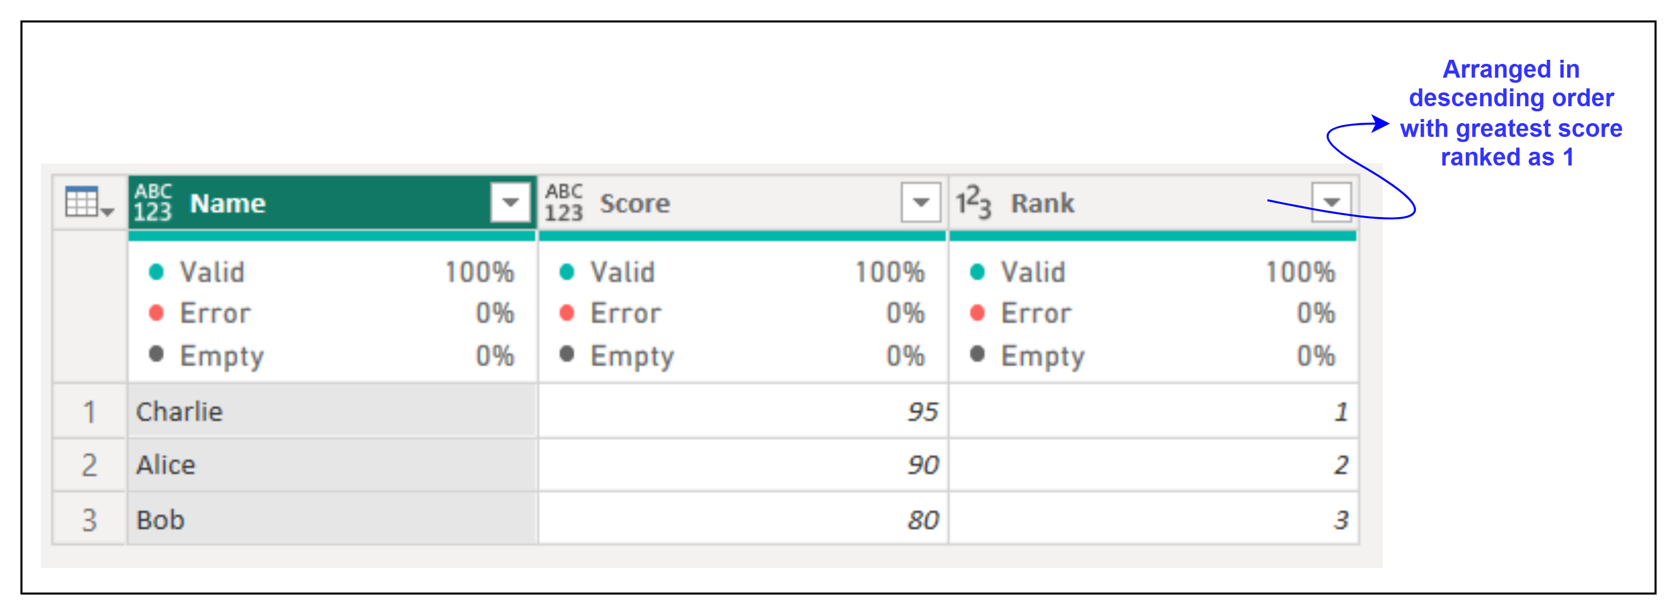
4. Table.AddRankColumn
Description: Adds a column that ranks rows based on a value column.
Example:
Result:
Use Cases:
Ranking performance or metrics.
Creating leaderboards.

